Slide 1
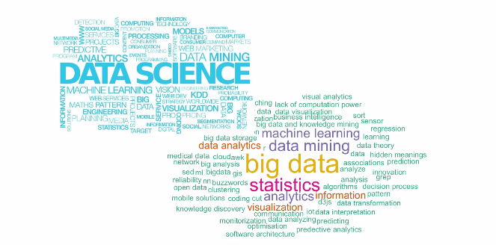
Data Science – Day 7

Slide 2
Quiz
a) Higher the MSE, better the model – True or False
b) The function used to locate the position of a substring within a string ________________________
c) Independent variables are also known as _____________________________
d) A single function used to access the rows and columns _______________________
e) Linear regression could be only used for predicting continuous variables – True or False
State the null hypothesis of below statement
1) Dhoni’s football experience in his childhood influenced his wicket keeping skills.

Slide 3
Quiz
g) Write the function to extract the 3,4,5 columns of dataset mtcars
h) The function used to access the random subset from the given data collection _________________
i) Industrial confidence interval to reject the null hypothesis _____________________
j) Parameter to indicate that there is a header at first row while reading CSV _____________
k) Independent variables in LR should be only numeric variables – T /F
l) An index way of selecting all rows except 10th row in a dataframe

Slide 4
Quiz
m) R way of showing that variable has less significance to dependent variable as the part of lm :
n) p value is _____________________________________________
o) When the correlation between two variables is negative, it implies _______________________
p) Accessing the first row of a list using list[[0]] will result in __________________________
q) Differences between list and data frame _____________________________________
r) First data pattern which should be looked upon during the phase of a data analysis

Slide 5
Quiz
s) The way of clubbing together all data wrangling operations with the help of tidy verse could be done through __________ symbol
t) Linear modeling is a parametric function – T /F
u) Effective way of referring a data frame instead of labelling it every time whenever we want to use its columns _____________________
v) While identifying the significance, its always a better practice to reject alternate hypothesis – T/F
w) Residual is nothing but the difference between ___________ and _______________
x) Central Limit theorem says _______________________________________________
y) Function to convert a floating decimal to Integer __________________________

Slide 6
Quiz
z) Sql way of accessing the data from a data frame could be done through ________________
1) The function to validate whether there is a missing value in a data frame column ______________
2) We could have more than one dependent variables in a linear regression
3) Package which is handy while accessing a C++ function within R __________________
4) The difference in indexing in R comparing to other standard languages such as C++, Python ________________________
5) Define intercept in Linear Regression

Slide 7
Quiz

